Slide 1

Applied Machine Learning (BUAN 6341) Lecture 4
Harpreet Singh
Fall 2022
Notes:
Any questions before we start today’s lecture?

Slide 2
Support Vector Machine

Slide 3
Linear SVM Classification – Hard Margin
x
New data point
Prediction for new point
x
x
The decision boundary is too close to the data
Another way to say it is that the decision boundary is believing the data too much. The decision boundary was very sensitive to training data.
What does this mean?
• Overfitting!

Slide 4
Linear SVM Classification – Hard Margin
Move the decision boundary to the midpoint between the edges of the group (support vectors)
x
Margin
Prediction for new data point
x
x
New data point
What can we say about the decision boundary?
This decision boundary is consistent with the data while committing least to it
The idea of finding the decision boundary of least commitment (maximum margin) in the set of linearly separable data is the main idea behind Linear SVMs.
In other words, maximize the margin subject to the constraint that we should be able to classify everything correctly (Maximal Margin Classifier)

Slide 5
Problem Hard Margin
Outlier
x
Decision boundary in presence of outlier
x
New data point
Prediction for new data point
x
x
Outlier
Outlier

Slide 6
Solution Soft Margin
x
Decision boundary based on these points
Allow misclassification in training to get better predictions – Bias-Variance Tradeoff.
Similar to regularizing linear regression.
x
How about these two points?

Slide 7
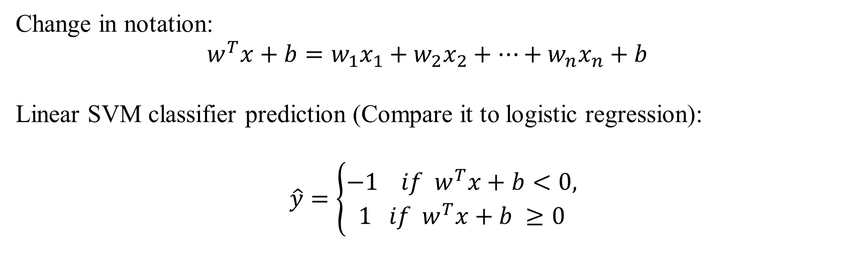
Linear SVM Classification
Change in notation:
$$w^{T}x+b=w_{1}x_{1}+w_{2}x_{2}+…+w_{n}x_{n}+b$$
Linear SVM classifier prediction (Compare it to logistic regression):
$$\hat{y}=\left\{\begin{aligned}−1 if w^{T}x+b<0, \\ 1 if w^{T}x+b ≥0\end{aligned}\right.$$

Slide 8
Linear SVM Classification
Binary classification can be viewed as the task of separating classes in feature space:
Which one is the optimal?
w^{T}x + b = 0
w^{T}x + b > 0
w^{T}x + b < 0

Slide 9
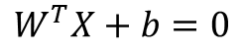
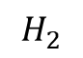
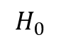
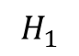
Linearly separable data
$$W^{T}X+b=0$$
$$H_{1}$$
$$H_{0}$$
$$H_{2}$$
Support Vector

Slide 10
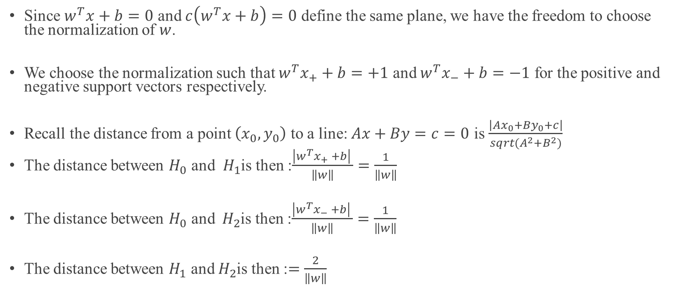
Support Vector
Since $w^{T}x+b=0$ and $c\left(w^{T}x+b\right)=0$ define the same plane, we have the freedom to choose the normalization of $w$.
We choose the normalization such that $w^{T}x_{+}+b=+1$ and $w^{T}x_{−}+b=−1$ for the positive and negative support vectors respectively.
Recall the distance from a point $\left(x_{0},y_{0}\right)$ to a line: $Ax+By=c=0$ is $\frac{\left|Ax_{0}+By_{0}+c\right|}{sqrt(A^{2}+B^{2})}$
The distance between $H_{0}$ and $H_{1}$is then :$\frac{\left|w^{T}x_{+} +b\right| }{\left\|w\right\|}=\frac{1}{\left\|w\right\|}$
The distance between $H_{0}$ and $H_{2}$is then :$\frac{\left|w^{T}x_{−} +b\right| }{\left\|w\right\|}=\frac{1}{\left\|w\right\|}$
The distance between $H_{1}$ and $H_{2}$is then :$=\frac{2}{\left\|w\right\|}$

Slide 11
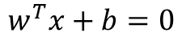
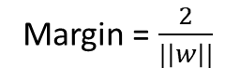
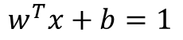
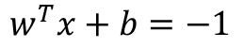
Linearly separable data
$$w^{T}x+b=1$$
$$w^{T}x+b=0$$
$$w^{T}x+b=−1$$
Margin = $\frac{2}{|\left|w\right||}$

Slide 12
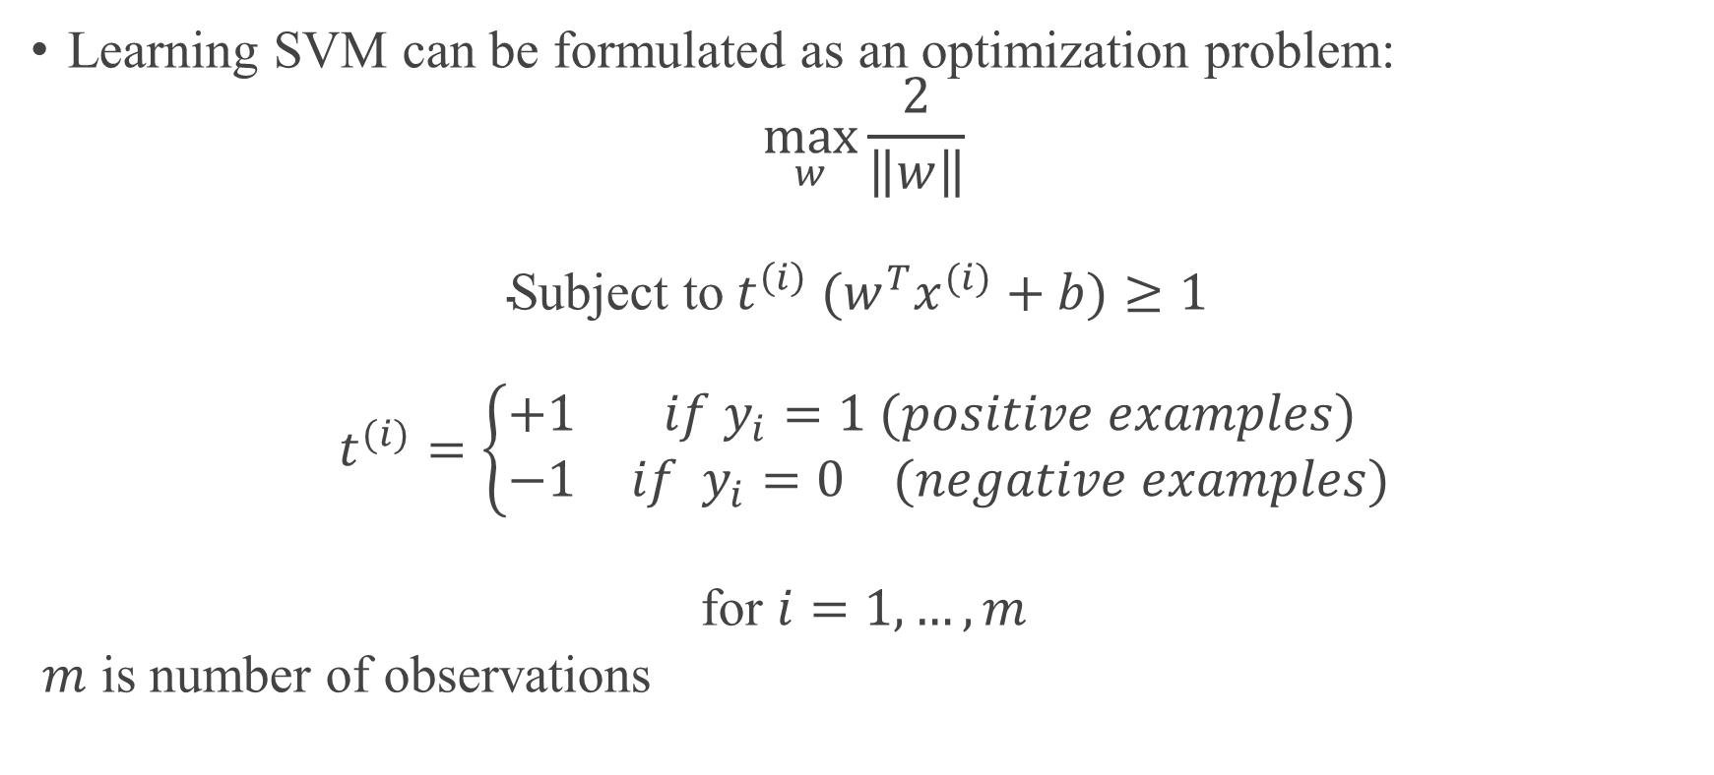
SVM - Optimization
Learning SVM can be formulated as an optimization problem:
$$\max_{w}{\frac{2}{\left\|w\right\|}}$$
$$\text{Subject} \text{to} {t^{\left(i\right)} (w}^{T}x^{(i)}+b)≥1$$
$$t^{(i)}=\left\{\begin{matrix}+1 & if y_{i}=1 (positive examples) \\ −1 & if y_{i}=0 (negative examples)\end{matrix}\right.$$
$$\text{for} i=1, …, m$$
$m$ is number of observations

Slide 13
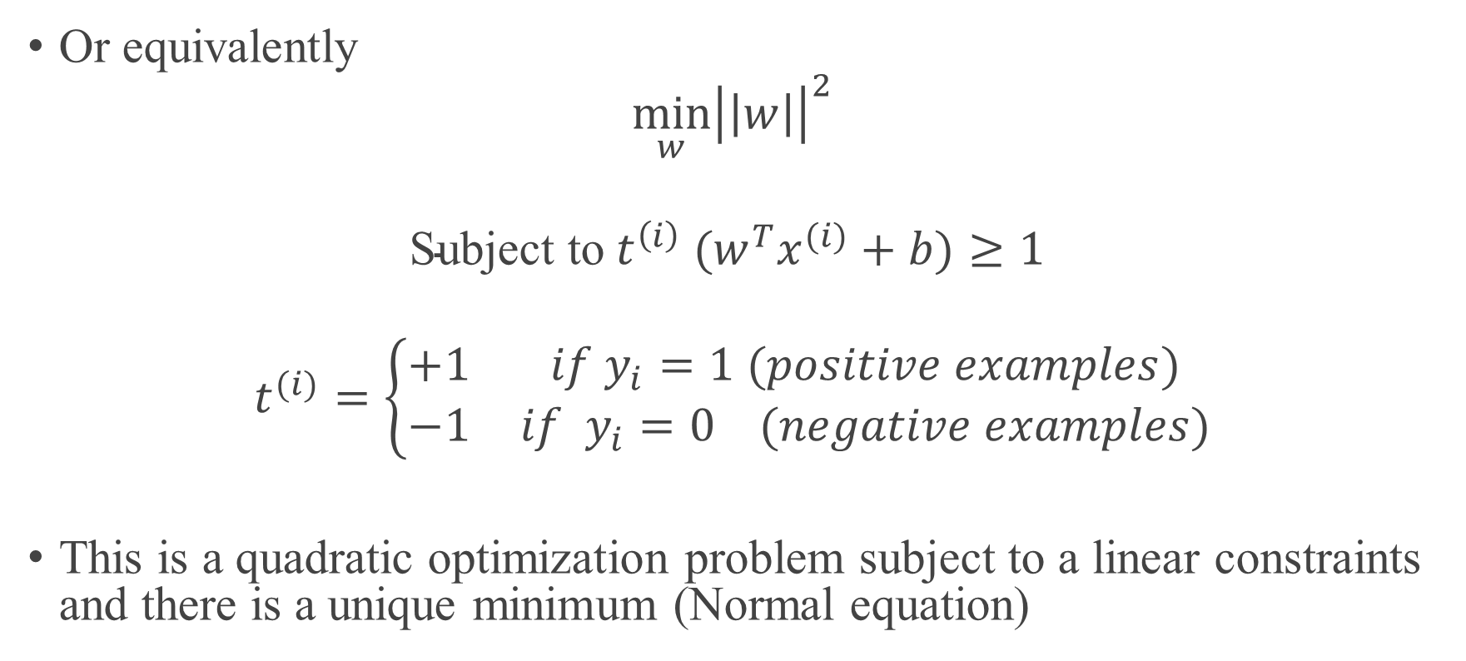
SVM - Optimization
Or equivalently
$$\min_{w}{{\left|\left|w\right|\right|}^{2}}$$
$$\text{Subject} \text{to} {t^{\left(i\right)} (w}^{T}x^{(i)}+b)≥1$$
$$t^{(i)}=\left\{\begin{matrix}+1 & if y_{i}=1 (positive examples) \\ −1 & if y_{i}=0 (negative examples)\end{matrix}\right.$$
This is a quadratic optimization problem subject to a linear constraints and there is a unique minimum (Normal equation)

Slide 14
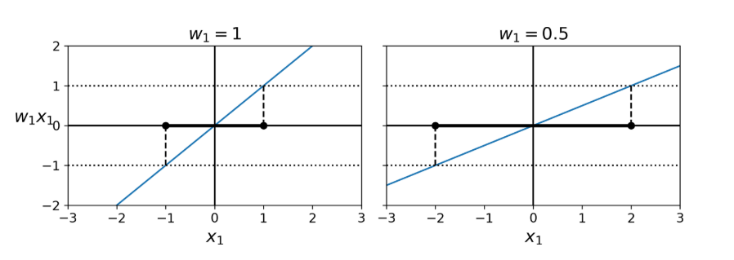
SVM - Optimization
Smaller weight vector results in larger margin

Slide 15
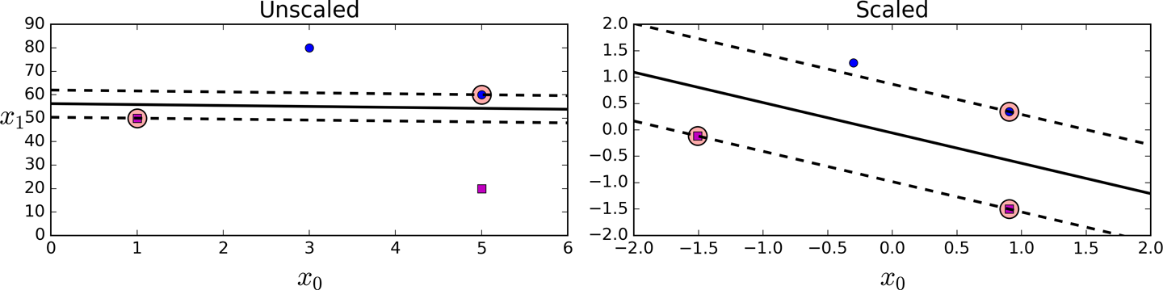
SVM
Image source : Book - Hands-On Machine Learning with Scikit-Learn and TensorFlow: Concepts, Tools, and Techniques to Build Intelligent Systems

Slide 16
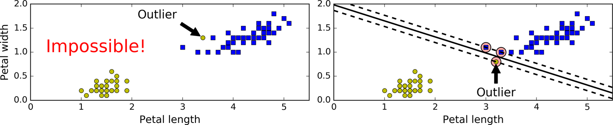
Hard Margin Classification
Hard margin classification: all instances be off the decision boundary
Potential issues:
Only works if the data is linearly separable
Sensitive to outliers
Image source : Book - Hands-On Machine Learning with Scikit-Learn and TensorFlow: Concepts, Tools, and Techniques to Build Intelligent Systems

Slide 17
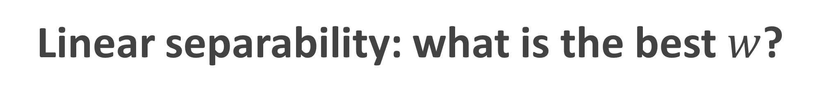
Linear separability: what is the best $w$?
The points can be linearly separable but there is a very narrow margin
But possibly the large margin solution is better, even though one constraint is violated.

Slide 18
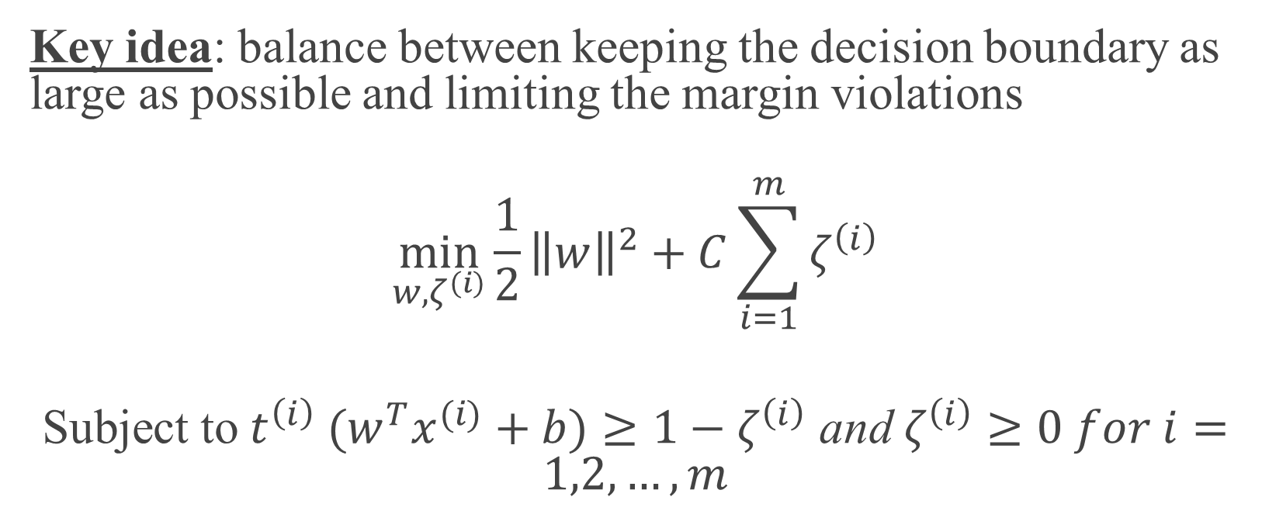
Soft-SVM Optimization
Key idea: balance between keeping the decision boundary as large as possible and limiting the margin violations
$$\min_{w,ζ^{\left(i\right)}}{\frac{1}{2}{\left\|w\right\|}^{2}+C\sum_{i=1}^{m}{ζ^{\left(i\right)}}}$$
$\text{Subject} \text{to} {t^{\left(i\right)} (w}^{T}x^{(i)}+b)≥1−ζ^{\left(i\right)}$ and $ζ^{\left(i\right)}≥0 for i=1,2,…,m$

Slide 19
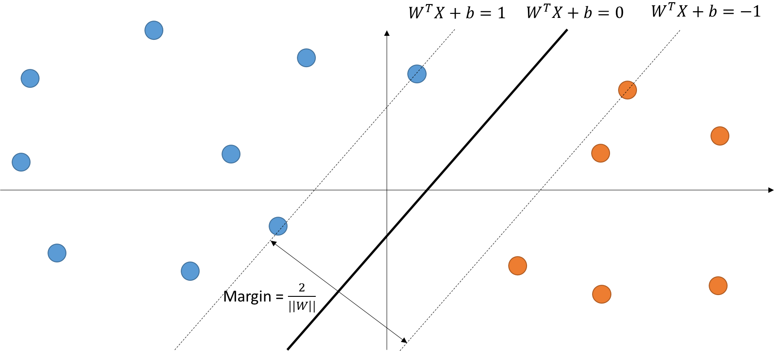
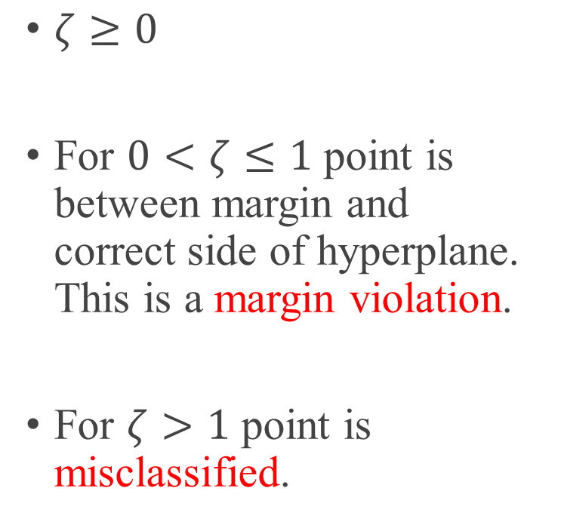
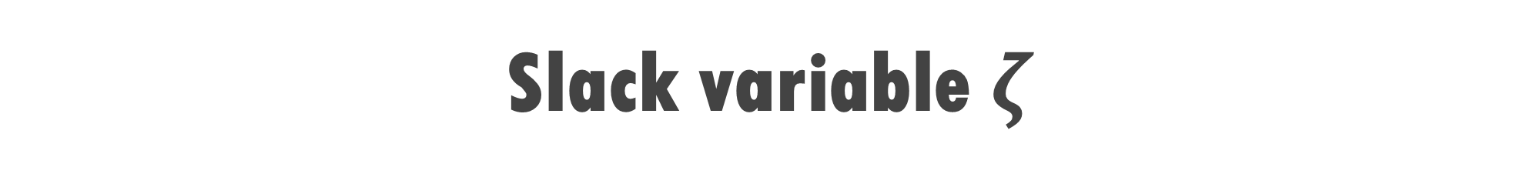
Slack variable $ζ$
$ζ≥0$
For $0<ζ≤1$ point is between margin and correct side of hyperplane. This is a margin violation.
For $ζ>1$ point is misclassified.

Slide 20
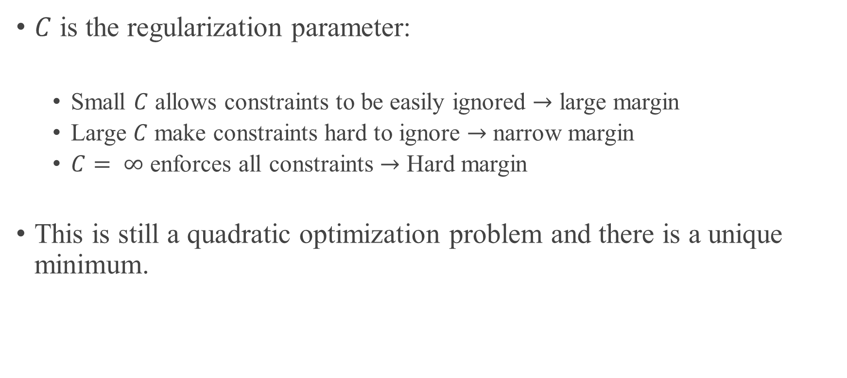
Soft Margin solution
$C$ is the regularization parameter:
Small $C$ allows constraints to be easily ignored $→$ large margin
Large $C$ make constraints hard to ignore $→$ narrow margin
$C= ∞$ enforces all constraints $→$ Hard margin
This is still a quadratic optimization problem and there is a unique minimum.

Slide 21
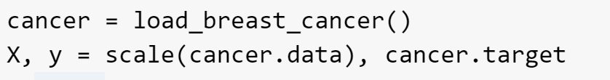
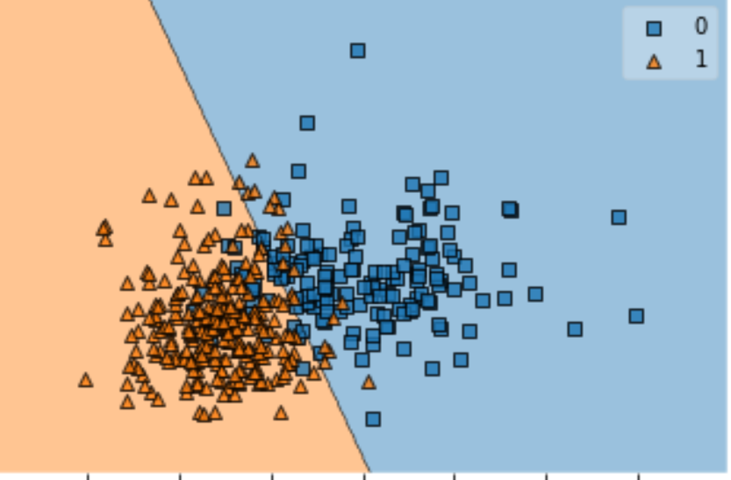
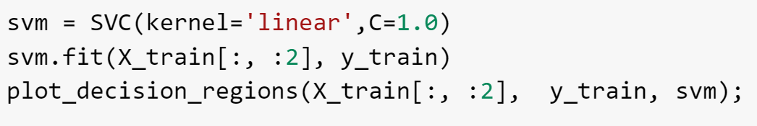
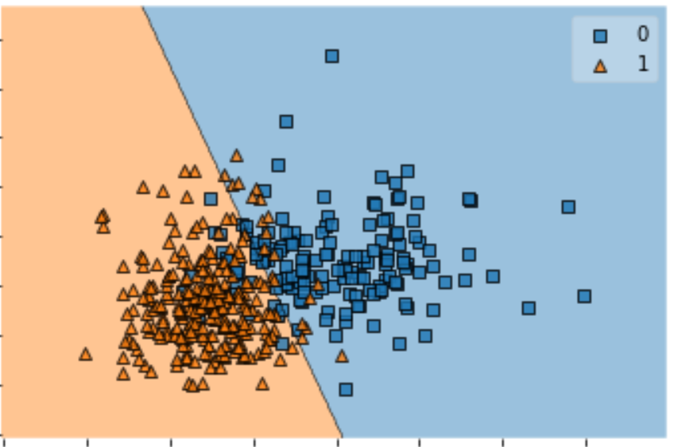
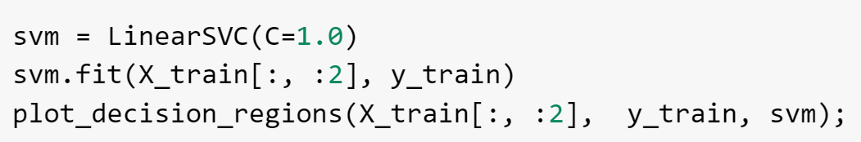
Linear SVC - Code

Slide 22
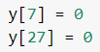
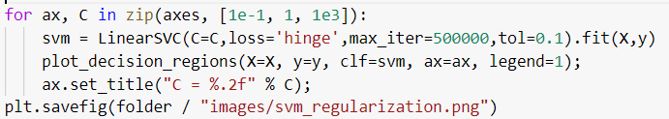
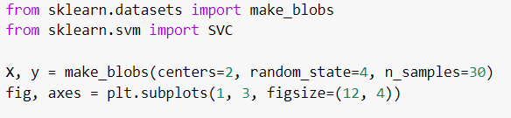
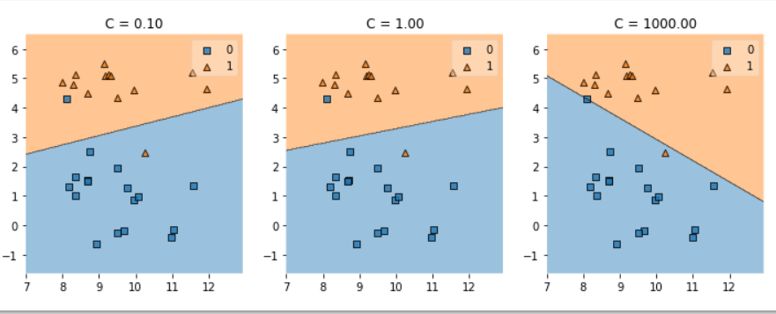
Regularization-Code

Slide 23
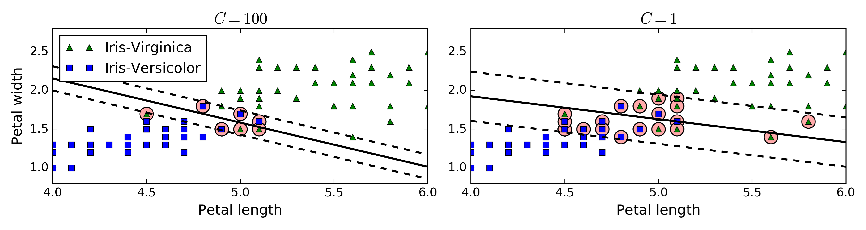
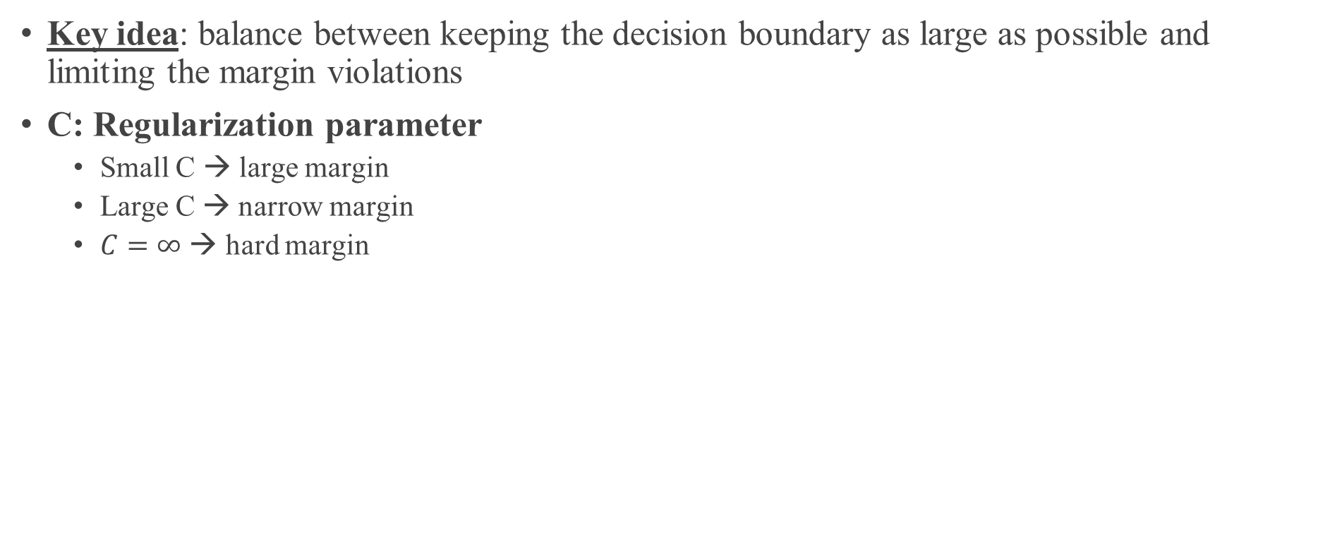
Regularization – Effect on Margin
Key idea: balance between keeping the decision boundary as large as possible and limiting the margin violations
C: Regularization parameter
Small C → large margin
Large C → narrow margin
$C=∞$ → hard margin
Image source : Book - Hands-On Machine Learning with Scikit-Learn and TensorFlow: Concepts, Tools, and Techniques to Build Intelligent Systems

Slide 24
Tip
If your SVM model is overfitting, you can try regularizing it by reducing C.
Unlike Logistic Regression classifiers, SVM classifiers do not output probabilities for each class.

Slide 25
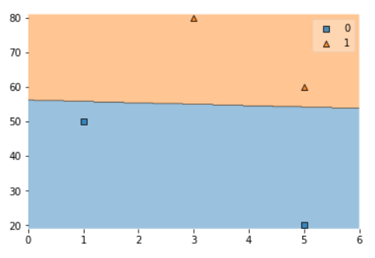
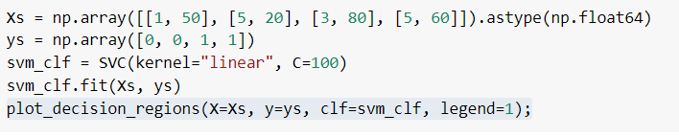
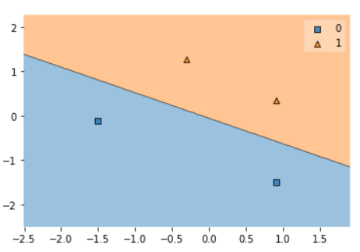
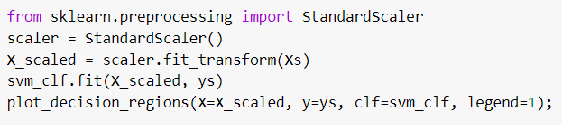
Effect of Scaling

Slide 26
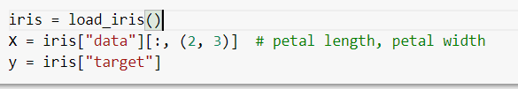
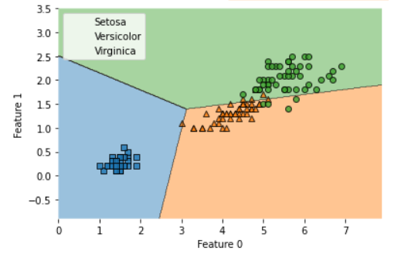
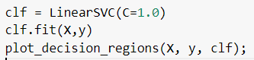
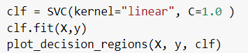
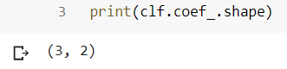
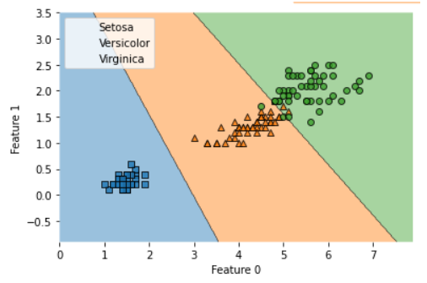
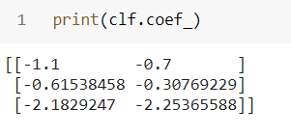
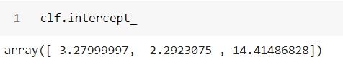
MultiClass- Code

Slide 27
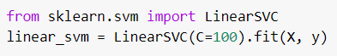
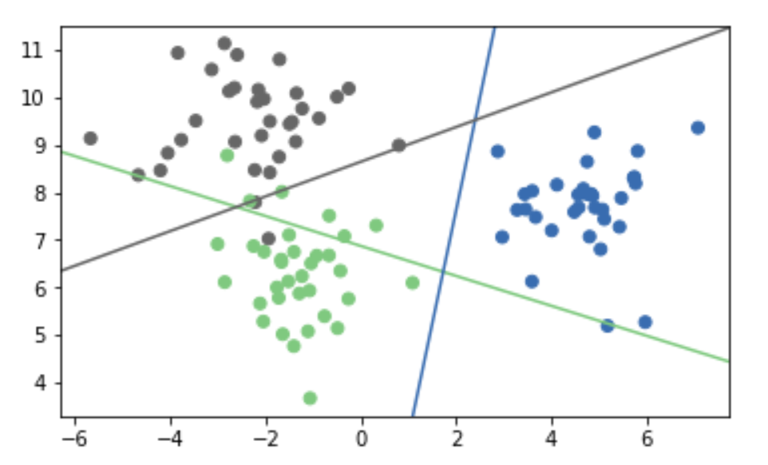
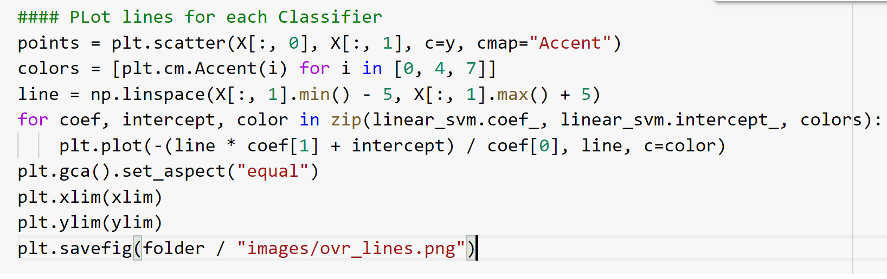
Multi-Class- OVR

Slide 28
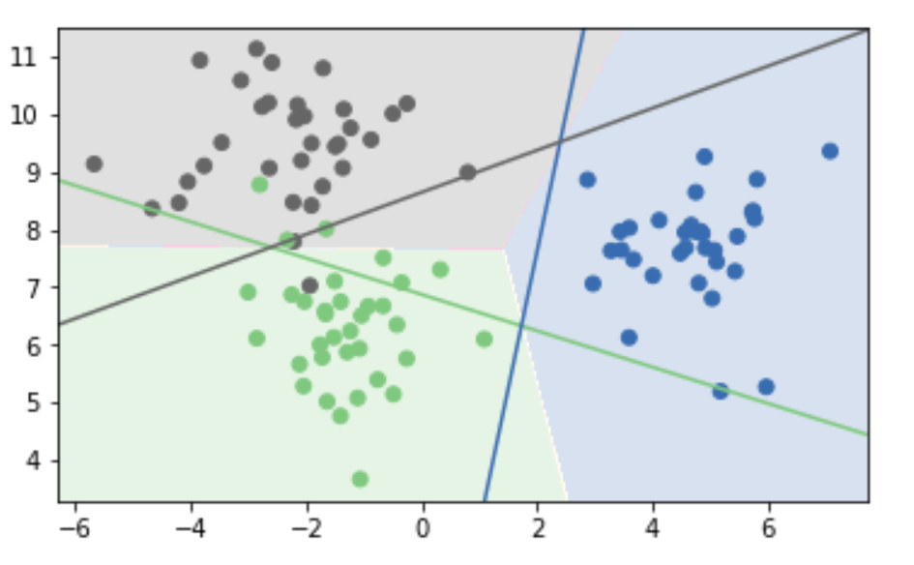
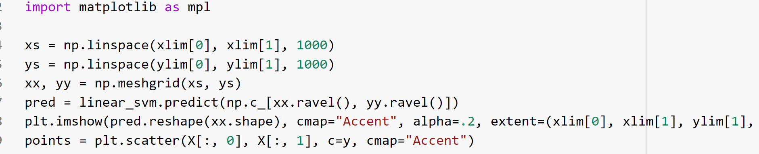
OVR- predictions and decision boundary

Slide 29
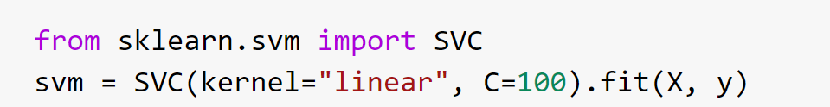
OVR vs OVO - code
OVR
OVO

Slide 30

OVO- predictions and decision boundary

Slide 31

Scikit Learn
OvO: only SVC
OvR: default for all linear models except for logistic regression
LogisticRegression (multi_class='auto')
clf.decision_function ($w^{T}x+b$)
logreg.predict_proba
SVC(probability=True) - will discuss later – usually takes long and results are not that good

Slide 32
Solver Choices
Don’t use SVC(kernel='linear'), use LinearSVC
For n_features >> n_samples: Lars (or LassoLars) instead of Lasso.
For small n_samples (<10.000?), don’t worry.
LinearSVC, LogisticRegression: dual=False if n_samples >> n_features
LogisticRegression(solver="sag") for n_samples large.
Stochastic Gradient Descent for n_samples really large

Slide 33
Non-linear SVMs
Datasets that are linearly separable with some noise work out great
0
x
But what if the dataset is not that perfect?
x²
0
x
0
x
General idea: the original feature space can always be mapped to some higher-dimensional feature space where the training set is separable

Slide 34

Example

Slide 35
Kernel Trick
Adding polynomial features is inefficient.
Given a constrained optimization problem, known as the primal problem, it is possible to express a different but closely related problem, called its dual problem.
The solution to the dual problem typically gives a lower bound to the solution of the primal problem, but under some conditions it can even have the same solutions as the primal problem.
the SVM problem meets these conditions, so the solution to dual problem is also a solution for primal problem.
Kernel trick, is defining a dual problem, such that the solution is same as the feature transformation.

Slide 36

Kernel Trick
Dual form of Linear SVM objective
$$\underset{α}{minimize}{\sum_{i=1}^{m}{\sum_{j=1}^{m}{α^{\left(i\right)}}}}α^{\left(j\right)}t^{\left(i\right)}t^{\left(j\right)}x^{\left(i\right) T}x^{\left(j\right)}−\sum_{i=1}^{m}{α^{\left(i\right)}}$$
$$\text{s}\text{ubject} \text{to} α^{\left(i\right)}≥0 for i=1,2,…,m$$

Slide 37


The “Kernel Trick”
Second-degree polynomial mapping
Kernel trick for Second-degree polynomial mapping
Example source : Book - Hands-On Machine Learning with Scikit-Learn and TensorFlow: Concepts, Tools, and Techniques to Build Intelligent Systems

Slide 38


Similarity Features
Notes:
Another technique to address nonlinear problems is to use similarity function, that basically measures how much each instance resembles a particular landmark.
So let take this simple one dimensional dataset. In this example, we can consider two landmarks, like –2 and 1. One way that we can define the similarity is to take consider geometric distance. If a new point is geometrically close to a landmark, there is a higher chance to have the same label. As the points get further and further, it will be considered less similar to the landmark.
So, we can expect a bell shape like these two lines in the left plot.
The Gaussian Radial Basis Function can be used to create the bell shape you can see here.
In this function l is a landmark and x is a new instance.
Gamma is a parameter that controls how flat or tall the bell shape can get.
Now we are ready to compute the new features. For example, let’s look at the instance x1 = –1: it is located at a distance of 1 from the first landmark, and 2 from the second landmark.
Now we are dropping the original feature and replace it with new features, which in this case is x_2 and x_3. Assuming a value of gamma to be something line 0.3,
Therefore its new features are x2 = exp (–0.3 × 1^2) ≈ 0.74 and x3 = exp (–0.3 × 2^2) ≈ 0.30. The plot on the right shows the transformed dataset (dropping the original features). As you can see, it is now linearly separable.
You may wonder how to select the landmarks. The simplest approach is to create a landmark at the location of each and every instance in the dataset. This creates many dimensions and thus increases the chances that the transformed training set will be linearly separable.

Slide 39

Examples of kernel functions
Example source : Book - Hands-On Machine Learning with Scikit-Learn and TensorFlow: Concepts, Tools, and Techniques to Build Intelligent Systems

Slide 40





Kernel SVM -Code

Slide 41

Kernel SVM-Parameter C

Slide 42

gamma – rbf kernel

Slide 43

Kernel SVM (rbf-Gamma)

Slide 44

Kernel SVM (poly-Gamma)

Slide 45

Kernel SVM (poly-degree)

Slide 46
Pre-Processing
Kernel use inner products or distances.
StandardScaler or MinMaxScaler
Gamma parameter in RBF directly relates to scaling of data and n_features – the default is 1/(X.var() * n_features)

Slide 47


Linear Kernel – No tuning

Slide 48

Grid search – Single Kernel
Final model should be picked based on best mean cross validation score

Slide 49



Grid search – Multiple Kernel

Slide 50

Grid search – SVM
Preprocessing – Atleast scale your inputs for SVM models
Better to do grid search for some of the parameters in log scale

Slide 51
Tip
With so many kernels to choose from, how can you decide which one to use?
As a rule of thumb, you should always try the linear kernel first, especially if the training set is very large or if it has plenty of features.
If the training set is not too large, you should try the Gaussian RBF kernel as well.
Then if you have spare time and computing power, you can also experiment with a few other kernels using cross-validation and grid search, especially if there are kernels specialized for your training set’s data structure.

Slide 52
Computational Complexity
The LinearSVC class is based on the liblinear library, which implements an optimized algorithm for linear SVMs.
It does not support the kernel trick, but it scales almost linearly with the number of training instances and the number of features: its training time complexity is roughly O(m × n).
The SVC class is based on the libsvm library, which implements an algorithm that supports the kernel trick.
The training time complexity is usually between O(m² × n) and O(m³ × n).
LinearSVC is much faster than SVC(kernel="linear")

Slide 53
SVM Regression

Slide 54

Objective
SVM Regression tries to fit as many instances as possible on the street while limiting margin violations

Slide 55

Nonlinear Regression

Slide 56




SVM- Regression- Code

